Slide 1
GitHub for Epidemiologists
with some Git and some RStudio
See go.unc.edu/github4epi
Mark Klose, Epidemiology PhD Student
2023-03-31

Slide 2
Workshop Takeaways
Takeaways
Use the simplest option whenever possible. Sometimes, email is fine.
Solo: RStudio Project -> Git -> GitHub
Git is on your computer; GitHub is on the cloud.
Solo: GitHub -> RStudio Project
You add items to the staging area. Check status at any time.
Collab: fork, make changes, pull request
Items in the staging area are committed to a permanent snapshot
Collab: branch to avoid merge conflicts
Git stores the diffs between files; going to an earlier commit is another diff.
Recover data with reflog, revert

Slide 3
How would you share code with colleagues?
Motivating question:

Slide 4
Most common options
Share code?
Email
…but then you find a bug and need to email again.
…and only share it with recipients, when everyone could have used it.
DropBox
…then you find a bug, and need to update the file again
…now half the research team has the old version, some the new version, and everyone a headache

Slide 5
In 90% of cases, email and DropBox will do.
Share code?
For technology, always default to the easiest way of doing things.
If there is a faster way of doing things, test it out.
If there is a more robust way of doing things, test it out.
As projects grow in complexity, technology grows in complexity.
Email and DropBox are not robust to many incremental changes, rather one large sharing of information.
What is a better tool for sharing incremental changes?

Slide 6
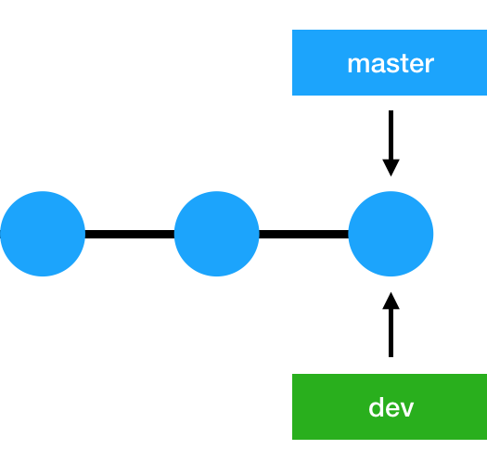
Git…
SHARE CODE?
Framework for what incremental changes have been made and where the next incremental change should go.
A history of little files saying “I added/subtracted these characters on this line in this file” on your computer.

Slide 7
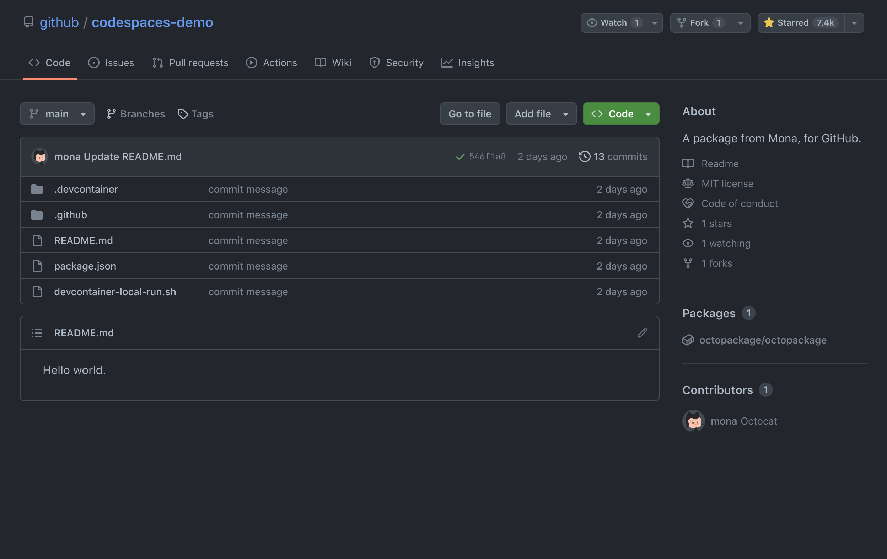
…and GitHub
SHARE CODE?
“Free” service to host files, incremental changes, and some other fun stuff.
GitHub is an interface. Git is where the magic truly happens.
It’s always good to have a backup.

Slide 8
The following examples use the following tools. (5 min break)
Git -
https://git-scm.com/downloads
GitHub (make an account!) - https://github.com/
R +RStudio - https://posit.co/download/rstudio-desktop/

Slide 9
Where did this presentation come from?
Happy git and GitHub for the User
As the EPID department modernizes and starts incorporating R more, I expect many people will use RStudio (heck, I made you download it).
There is decent support between RStudio, Git, and GitHub.
Jenny Bryan, currently as Posit (RStudio) and formerly of UBC, published a WONDERFUL bookdown site that I take inspiration from.
The book link is: https://happygitwithr.com/index.html
But, books are long, 2 hours is less long.
See the GitHub repository at go.unc.edu/github4epi

Slide 10
How do I incorporate Git with my upcoming work?
Git BASICS

Slide 11
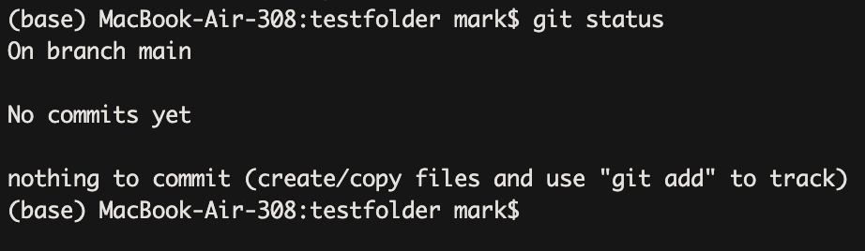
New project: initialize repository from Command Line
GIT BASICS
Git isn’t totally magic, so it only looks in the current folder (working directory) and subfolders.
This is the repository (repo)
Git tracks additions and subtractions within the repository, called diffs.
Try on your own:
Open RStudio
In the terminal pane, make a new test folder with mkdir testfolder
Initialize the Git repository with git init testfolder
Move into new repo with cd testfolder
See that the repository exists by running git status

Slide 12
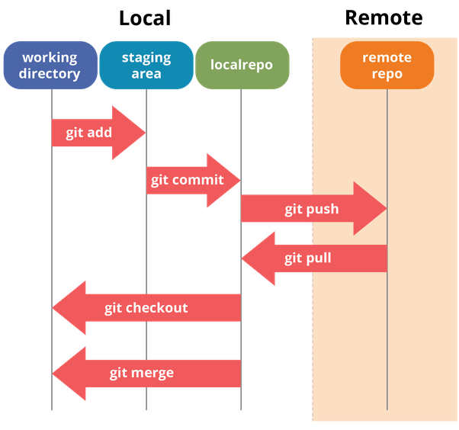
Everything revolves around the Staging Area
GIT BASICS
Staging area = “I want the changes of these files to be added to the public record”
Add files to staging area
Commits to repository = stone-carving the public record
File deltas (change), Commit message, and Commit hash
Use git status to see current status

Slide 13
2-minute exercise: your first commit!
GIT BASICS
Step 1: Make a text, code, or data file.
Point and click from RStudio. Save your file to the current folder
echo “hello world” > hello.txt in the terminal
Step 2: Add your file to the staging area.
In the terminal: git add hello.txt
Shortcut for adding multiple files:
git add .
Step 3: Commit your changes to the repository.
You are REQUIRED to add a commit message. Why not make it informative?
git commit –m “<MESSAGE HERE>”
If you don’t add a message, a vim editor opens. To quit, do :wq

Slide 14
∞-minute exercise: your gajillionth commit
GIT BASICS
Step 1: keep making changes to files.
Code, simulated data, non-sensitive data
Step 2: add files to the staging areas with git add .
Step 3: commit changes to repository with
git commit –m “<MESSAGE>”
Return to step 1.

Slide 15
Side Note 1: .gitignore files
GIT BASICS
git add . adds all modified files in the current folder to the staging area. This includes some hidden files, like .DS_STORE on MacOS.
During the add process, one of the steps included is “look in file .gitignore and DON’T add any files or folders listed there.”
On each line of .gitignore, put a filename (like “hello.txt”), folder (“test/”), or pattern (“*.pdf” to not add any PDFs) to have Git, well, ignore their modifications. This is useful if you have any sensitive information (database keys, usernames, etc.)
More information at this link

Slide 16
”Hey, isn’t this only storing changes on my local computer? How can I share my repository then?”
Probably you, right now.
That’s why we have our next section.

Slide 17
How do I incorporate Git and GitHub with previous projects? (5 min break)
Git USE CASES

Slide 18
Introducing……GitHub!!!
GIT USE CASES
GitHub is an online service which can store your repositories, either publicly or privately
But, as you add more features, you add complexity. How would you solve the following design decisions?
Authentication: how can I be sure the person sending information is allowed to make changes?
Conflicts: if multiple people are using the same repository, how can I ensure that nobody writes over information already there?
There is one of me, hopefully many of you. Copy error message into Google and see if StackOverflow already has an answer!!!

Slide 19
5-minute exercise: Addressing Authentication
Git USE CASES
Following Happy GitHub for the useR, Chapter 10
Using SSH keys – although tougher to set up, prevents less headache later (i.e. setting usernames and passwords locally), but more future proof.
Step 1: Tools > Global Options > Git/SVN; find box labeled “SSH Key”.
If empty, click “create SSH key”. Copy public key.
If not empty, click “View Public Key”. Copy public key.
Step 2: GitHub.com > Profile > Settings > SSH and GPG Keys
Click add new SSH key
Paste public key from Step 1 into the last box.
Step 3: ssh –T git@github.com
Check error: SHA256:uNiVztks…[GARBAGE]…j3tD2s

Slide 20
Use Case 1: RStudio Project to GitHub
Git USE CASES
Steps (5 minute exercise)
RStudio projects are powerful, self-contained. Just a couple files.
We can use the usethis package. Load the package with:
install.packages(“usethis”)
library(usethis)
Chapter 17 in Happy Git with R
I think this is what most people will use from this workshop.
Step 1: Copy path of repository
Files pane > More > Copy Folder Path to Clipboard
Step 2: in the R console, do create_project(“PATH”)
Now, we are working in an RStudio project AND Git repository.
Step 3: in the R console, do use_github()
Step 4: check GitHub!

Slide 21
Use Case 2: New project, starting with GitHub (5 minute exercise)
GIT USE CASES
You are asked to do a new analysis, and you think to use GitHub ahead of time. Details in Chapter 15!
Step 1: Create repository on GitHub (point and click!)
Step 2: Copy ssh link within the green “Code” button
Step 3: with usethis, there is the command create_from_github( “<SSH LINK>”, destdir=“~/<PATH>”)
Alternate Step 3: under File > New Project, there is an option for Version Control.
Alternate Step 3: in terminal do git clone SSH_LINK

Slide 22
Use Case 3: Existing Project, GitHub first. This is tougher.
Git USE CASES
Step 1: On GitHub.com, make a new repository (like epihub)
Step 2: In R, do create_from_github( "https://github.com/YOU/YOUR_REPO.git", destdir = “~/PATH”)
Step 3: copy all your files over by hand, add, commit, push.

Slide 23
How do I use Git and GitHub with collaborators? (5 min break)
GIT WITH COLLABORATORS

Slide 24
GitHub is easy with one person. Many people though….
GIT WITH COLLABORATORS
The hidden .git repository stores the last commit in GitHub to tack changes onto.
If someone else pushes changes to the repository, then when you push changes, you won’t push to the correct place.
Sometimes, git is smart, and if there are no conflicts, it may be fine.
Other times, you get a “fast forward” issue.
Simple cases: git pull resolves this.
Complex cases: git pull --rebase or… copy and paste into Google. Seriously.

Slide 25
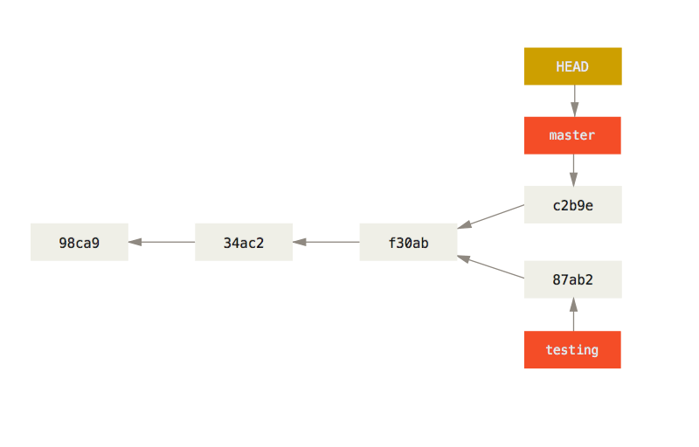
Advice: avoid conflicts!!
Git with Collaborators
To avoid the pesky pulling issue, you can go work on your own branch.
Git stores the HEAD as a pointer to the branch you work on.
The branch points to a commit.
There are various philosophies to how many/what types of branches to make.
See Branches in a Nutshell

Slide 26
5-minute exercise: Branching, two ways
GIT WITH COLLABORATORS
RStudio
In a repository we made today, find the Git panel.
Click “New Branch” (upper right corner?)
Enter a branch name.
Make an R Script, add, commit, and push it to the repository.
Check GitHub to see results
Terminal
Create a branch:
git branch BRANCHNAME
Move to the new branch:
git checkout BRANCHNAME
If checking status, note that new branch name used.
Make an R Script, add, commit, and push it to the repository.
Check GitHub to see results

Slide 27
Combining Branches with Pull Requests
Git with Collaborators
To combine your work on BRANCHNAME back into the main repository, you can open a Pull Request on GitHub.
Point-and-click is the best option in my experience.
Merging branches require the same commit history – so no mixing and matching between work of one repository and another repository.

Slide 28
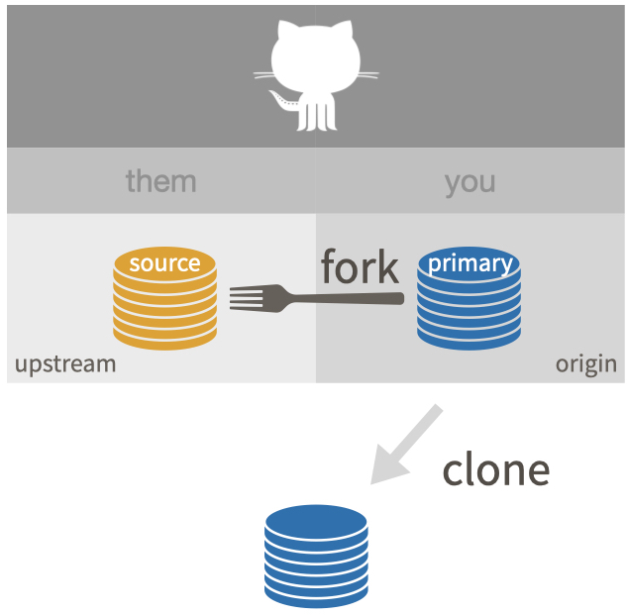
Working with “Collaborators”
Git with Collaborators
Sometimes, you have no write access to a codebase, only read-access. Example.
To fork the repository so you can make changes, you can use:
GitHub -> point and click in upper right corner (near profile picture). Forked repository allows you to read/write, and then can merge back with Pull Request.

Slide 29
5-minute exercise: Fork and pull request
GIT WITH COLLABORATORS
Go to the GitHub for Epidemiologists repository
Fork the repository to your own profile!
Within the blurbs folder, add a text file with a small list of things you learned today. Name the file with your ONYEN (to avoid conflicts)
Once you have added, committed, and pushed this little blurb, open a pull request to merge it back into the main repository.
I’ll try to approve them quickly!

Slide 30
Fun tidbits that you may find useful:
Git Extras!
git tag: Git SCM
GitHub Issues
git log: see all commits you have made
GitHub Projects
git reflog: it’s git log but more concise, includes the commit hash in case you need to…
GitHub Wiki
git revert: return to a previous commit, by git hash
This list of useful commands for a SWE
GitHub Releases and Packages
This blog post

